Slide 1

Wikipedia Graphic 1
Join the #CiteNLM campaign
as an individual
or host an event
at your institution.
Notes:
Alt text for this image (assigned to this image in here in PowerPoint & can also be copy/pasted for use on social media:
Square graphic divided into three sections. Top section is a photo of someone leaning their arms on a table while writing. Left section is a blue box with the text “94% of med students report using Wikipedia as a starting point for information. Source: nnlm.gov/ZfZ”. Right section is a white box with the text “Help us improve health information on Wikipedia.” then a white space for custom text, then ”Get involved: nnlm.gov/wiki”
A textbox is overlaid on the right side:
“Join the #CiteNLM campaign as an individual or host an event at your institution."
To customize this graphic for your own use, you may consider adding your institution’s logo to the upper righthand corner, and/or customizing the text in the textbox.

Slide 2

Join the #CiteNLM campaign
as an individual
or host an event
at your institution.
Notes:
Alt text for this image (assigned to this image in here in PowerPoint & can also be copy/pasted for use on social media:
Square graphic divided into three sections. Top section is a photo of a laptop keyboard with a stethoscope lying on it. Left section is a blue box with the text “Wikipedia is an important medical resource for professionals, students, and the public. Source: nnlm.gov/Zf4”. Right section is a white box with the text “Help us improve health information on Wikipedia.” then a white space for custom text, then ”Get involved: nnlm.gov/wiki”
A textbox is overlaid on the right side:
“Join the #CiteNLM campaign as an individual or host an event at your institution."
To customize this graphic for your own use, you may consider adding your institution’s logo to the upper righthand corner, and/or customizing the text in the textbox.

Slide 3

Join the #CiteNLM campaign
as an individual
or host an event
at your institution.
Notes:
Alt text for this image (assigned to this image in here in PowerPoint & can also be copy/pasted for use on social media:
Square graphic divided into three sections. Top section is a photo of someone holding up a smartphone in front of library stacks. On the phone the Wikipedia logo is displayed. Left section is a blue box with the text “Wikipedia hosts 200k+ health articles written in 250+ languages. Source: nnlm.gov/Zfo”. Right section is a white box with the text “Help us improve health information on Wikipedia.” then a white space for custom text, then ”Get involved: nnlm.gov/wiki”
A textbox is overlaid on the right side:
“Join the #CiteNLM campaign as an individual or host an event at your institution."
To customize this graphic for your own use, you may consider adding your institution’s logo to the upper righthand corner, and/or customizing the text in the textbox.

Slide 4

Join the #CiteNLM campaign
as an individual
or host an event
at your institution.
Notes:
Alt text for this image (assigned to this image in here in PowerPoint & can also be copy/pasted for use on social media:
Square graphic divided into three sections. Top section is a photo of hands typing on a laptop. Left section is a blue box with the text “Wikipedia’s health articles are read over 10 million times daily. Source: nnlm.gov/ZfJ”. Right section is a white box with the text “Help us improve health information on Wikipedia.” then a white space for custom text, then ”Get involved: nnlm.gov/wiki”
A textbox is overlaid on the right side:
“Join the #CiteNLM campaign as an individual or host an event at your institution."
To customize this graphic for your own use, you may consider adding your institution’s logo to the upper righthand corner, and/or customizing the text in the textbox.

Slide 5

Join the #CiteNLM campaign
as an individual
or host an event
at your institution.
Notes:
Alt text for this image (assigned to this image in here in PowerPoint & can also be copy/pasted for use on social media:
Square graphic divided into three sections. Top section is a photo of a person looking into a computer monitor, reading an article. Left section is a blue box with the text “Wikipedia’s health articles are readx 6.5+ billion times per year. Source: nnlm.gov/ZfJ”. Right section is a white box with the text “Help us improve health information on Wikipedia.” then a white space for custom text, then ”Get involved: nnlm.gov/wiki”
A textbox is overlaid on the right side:
“Join the #CiteNLM campaign as an individual or host an event at your institution."
To customize this graphic for your own use, you may consider adding your institution’s logo to the upper righthand corner, and/or customizing the text in the textbox.

Slide 6
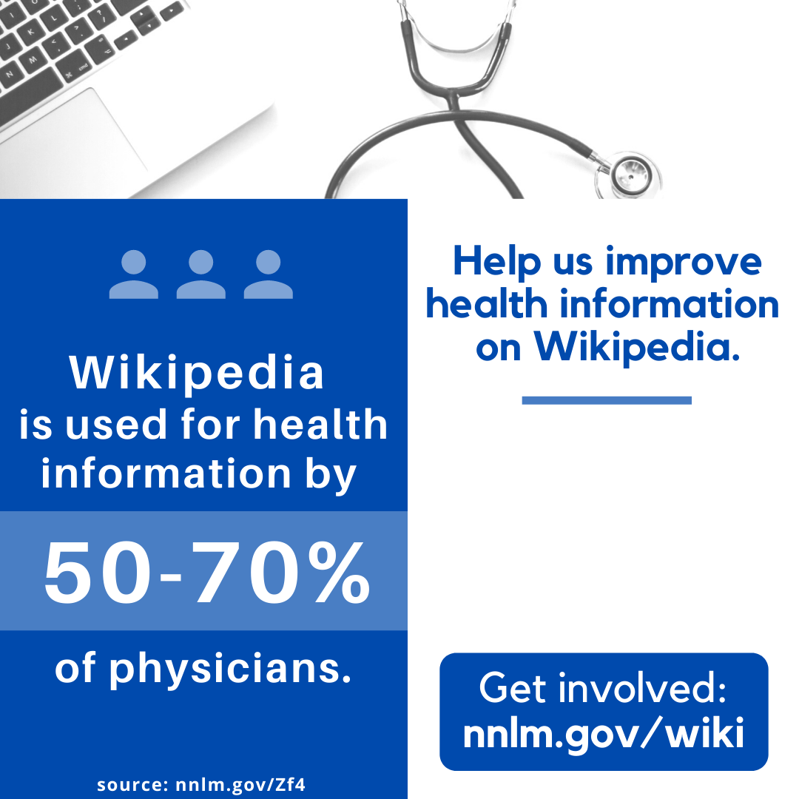
Join the #CiteNLM campaign
as an individual
or host an event
at your institution.
Notes:
Alt text for this image (assigned to this image in here in PowerPoint & can also be copy/pasted for use on social media:
Square graphic divided into three sections. Top section is a photo zoomed in on part of a laptop keyboard and a stethoscope. Left section is a blue box with the text “Wikipedia is used for health information by 50-70% of physicians. Source: nnlm.gov/Zf4”. Right section is a white box with the text “Help us improve health information on Wikipedia.” then a white space for custom text, then ”Get involved: nnlm.gov/wiki”
A textbox is overlaid on the right side:
“Join the #CiteNLM campaign as an individual or host an event at your institution."
To customize this graphic for your own use, you may consider adding your institution’s logo to the upper righthand corner, and/or customizing the text in the textbox.

Slide 7
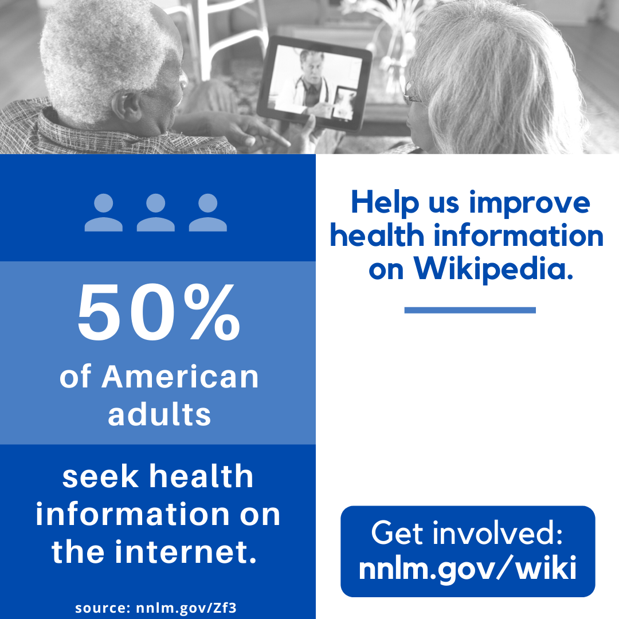
Join the #CiteNLM campaign
as an individual
or host an event
at your institution.
Notes:
Alt text for this image (assigned to this image in here in PowerPoint & can also be copy/pasted for use on social media:
Square graphic divided into three sections. Top section is a photo of two older adults attending a telehealth appointment on a tablet. Left section is a blue box with the text “50% of American adults seek health information on the internet. Source: nnlm.gov/Zf3”. Right section is a white box with the text “Help us improve health information on Wikipedia.” then a white space for custom text, then ”Get involved: nnlm.gov/wiki”
A textbox is overlaid on the right side:
“Join the #CiteNLM campaign as an individual or host an event at your institution."
To customize this graphic for your own use, you may consider adding your institution’s logo to the upper righthand corner, and/or customizing the text in the textbox.

