Slide 1
Technical Assistance Webinar: Regional Medical Libraries for the Network of the National Library of Medicine (UG4)
Presenters:
Alan VanBiervliet, MA, PhD, Extramural Programs Amanda J. Wilson, Office of Engagement and Training
Mike Davidson, Office of Engagement and Training
Notes:
Welcome – it’s so great to see xx people here today!
Thank you for joining this afternoon for this session.
We want to let you know what to expect today, so here are some logistics and information about materials we’re covering in the next hour:
This presentation is being recorded. The recording and slides available from the nnlm.gov website.
We have built in time at several points and at the end for questions and discussion.
The questions we address here and any we do not get to will be posted and available from the NNLM.gov website following this webinar.

Slide 2
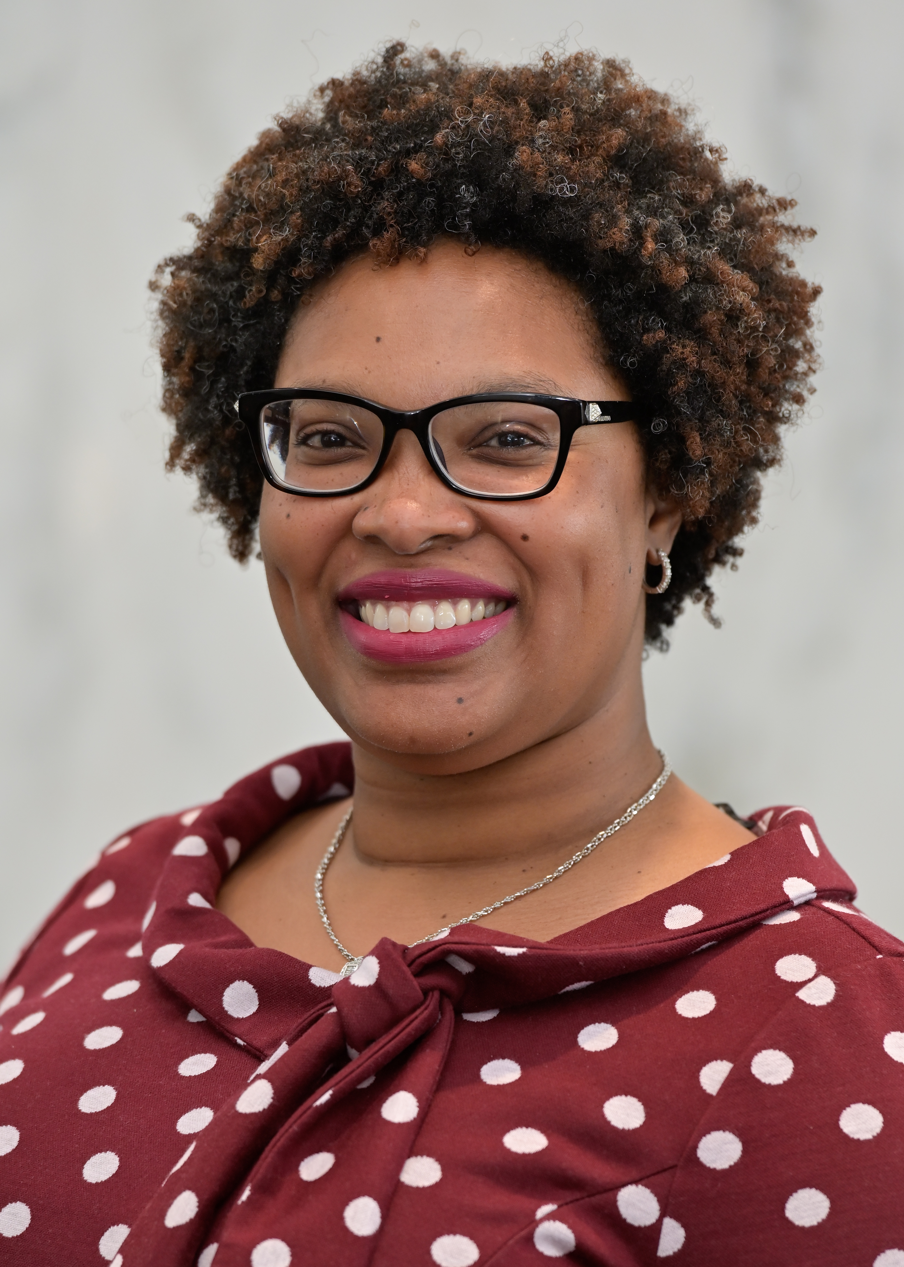
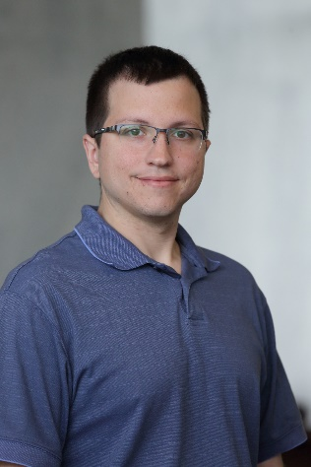
Speakers
Alan VanBiervliet, MA PHD -- UG4 Program Official
Amanda J. Wilson – Office of Engagement and Training
Mike Davidson – Office of Engagement and Training
Notes:
Introductions
As you’ll only be hearing our voices, Alan, Mike, and I wanted to let you know who’s speaking to you!

Slide 3
Agenda
Introduction to the Network of the National Library of Medicine (NNLM)
UG4 2021-2026 Application Processes and Strategies
Q&A
Notes:
We will be covering 2 main topics today. We will stop for questions between the segments and at the end of the hour.

Slide 4
Network of National Library of Medicine (NNLM)
Mission The mission of the NNLM is to advance the progress of medicine and improve the public's health by providing U.S. researchers, health professionals, public health workforce, educators, and the public with equal access to biomedical and health information resources and data.
Goals NNLM’s main goals are to work through libraries and other members to support a highly trained workforce for biomedical and health information resources and data, improve health literacy, and increase health equity through information.
Notes:
Starting with this next grant cycle, 2021-2026, the Network of the National Library of Medicine’s mission and goals are thus.
In the beginning, the Medical Library Assistance Act of 1965 (MLAA, P.L. 89-291) established the Network of the National Library of Medicine (NNLM) to assist the development of medical libraries’ services and to facilitate the dissemination and use of information related to health sciences. Over time, a growing emphasis has been placed on increasing the impact of the NNLM through partnerships with NLM and member organizations, including health sciences, hospital, academic, and public libraries, as well as public health departments, data organizations, and community-based organizations. Partnerships provide opportunities to engage with stakeholders in the public and private sectors, including researchers, librarians, health professionals, entrepreneurs and innovators, and the public – especially underrepresented populations,
Beginning with the 2021-2026 cycle, NLM has made changes and refinements to the Network of the National Library of Medicine (NNLM) program. First is the name. The acronym NNLM used to stand for ‘National Network of Libraries of Medicine.’ Now, NNLM stands for the ‘Network of the National Library of Medicine. ‘The name change recognizes that not all members are libraries of medicine. It is more focused and inclusive. .
While Network’s mission remains the same, goals for the NNLM are clarified and expanded. A newly specified goal that I would like to highlight for you is ‘to increase health equity through information.’
A second change is programmatic. Goal 2 of NLM’s 2017-2021 strategic plan is to reach more people in more ways through enhanced dissemination and engagement. Applying this focus to the Network and efforts to continually engage underserved and underrepresented populations with NLM resources and data communities, the 2021-2026 NNLM region structure balances regions and RML workloads.
The reorganization reconfigures regions and reduces the disparities between regions, as measured by total US population served and number of member libraries and organizations supported.
Also, region names are replaced with region numbers. The regions are ordered clockwise, starting with the region including NIH headquarters in Bethesda, MD.
The NNLM design remains the same, comprising grantee staff operating Regional Medical Libraries (RMLs), national Offices, and national Centers, with RMLs remaining THE integral component of NNLM.

Slide 5
Network Performance Measures
Continually build an inclusive, diverse Network through membership management;
Engage Network members in carrying out the mission of NNLM;
Employ multiple methods and bidirectional communications channels to inform regional activities;
Maintain a robust outreach and education program reaching the region’s communities and responsive to their needs;
Contribute to the development and implementation of national and multiregional initiatives – originating from national or local levels – that align with NLM’s scope;
Where possible, appropriate, and reasonable, leverage non-Network partners in the accomplishment of #1-5 above;
Regularly assess program and project performance in accomplishing aims #1-6 above.
Notes:
These Network Performance Measures demonstrate how NNLM promotes access to biomedical information to improve the public’s health. They were developed and approved in 2017.
Data that is collected and reported on NNLM activities aligns with these measures and metrics to tell the story of all the ways we provide impactful training, funding, and engagement opportunities for NNLM members and the public covering biomedical and health information.
Today the NNLM has over 8200 members. An engaged, diverse membership is the foundation of an effective Network. This is reflected as the first performance measure. Currently, members of the NNLM span the country: 90% of the U.S. population lives in a county with at least one NNLM member, while 93% of the total U.S. minority population lives in a county with at least one NNLM member. NNLM members are in are 21% of counties defined as Medically Underserved Areas (MUA). We’re doing well. We want to keep focus on improving in the 2021-26 cycle.
For performance measures 2, 3, and 6, collaborating and partnering with NNLM members and other partners is often through subawards. NNLM has been providing subawards for health information programs to universities, libraries, and community organizations for over 50 years. The Network has an existing transparent, structured approach for funding health information implementation projects, with 200-250 awarded each year in years 2 and 3 of the current. In year 4, which ended in April? It was 342!
4 and 5 are our bread and butter of the NNLM program. I’ll give examples of this in the last portion of my remarks.
Measure 7 is for evaluation and program management. The NNLM continues to develop and use mechanisms for project quality assurance. This includes centralized and standard tools for all NNLM grantee staff and NNLM members to use, for example, a national RFP evaluation standard and an outcome evaluation focus. . It also includes project implementation monitoring a Data Reporting System, which is real-time activity reporting.
NNLM has just released new dashboards which provide both quality project management and transparency. I’ll show you where to find them on the next slide!
Next, I will talk briefly about how NNLM operates to meet these performance measures, including the basic Network infrastructure and roles.

Slide 6
NNLM Organizational Handbook https://nnlm.gov/workbook
Notes:
Before I get into that, want to point out the NNLM Organizational Handbook which is available on nnlm.gov and at the link you see on the slide. It is a living document.
This resource includes the information I am covering today and much more. Let me walk you quickly through each section of the workbook.
The Overview section is just that, an overview of the NNLM program. This is where you’ll find a link to our new NNLM data dashboards, organized by state and region.
The Helpful Links section is where you’ll find these slides now, the recording and FAQs later, the link to the companion FOA to this one, and other information.
The Infrastructure and Operations section includes information about key NNLM operational structure and activities.
The Performance Measures section is where you’ll find not only the measures but the metrics we use currently to evaluate success on each measure.
The 2021-2026 Changes section provides a summary of what changed with this FOA, compared to current NNLM structure.
The Updates section details each change made to the workbook as we add information.
For the record, the changes from the current NNLM are 7, not 8, regions, an enhanced evaluation center, a clear focus on community-based and driven projects, and an explicit primary focus on reaching underrepresented populations through the goal of increasing health equity through information. We recognize that this requires changes in existing relationships with NNLM members for current awardees and potential new applicants. We appreciate the scale of the effort and look forward to the future.
We hope that this resources provides some insight into NNLM’s operations, structure, and accomplishments. Please start here first and check back frequently with any questions you may have.

Slide 7
Regional Medical Libraries (RMLs)
The shared functions of all RMLs are to:
Develop approaches to promote awareness of, improve access to, and enable use of NLM’s authoritative resources and data;
Develop and support a diverse workforce to access biomedical and health information resources and data, and to support data-driven research;
Engage authentically with current and future audiences to increase information access, with priority focus on underrepresented populations;
Provide community-driven innovative approaches and interventions for biomedical and health information access and use;
Contribute substantially to the development of vision, strategies, standards, oversight, and activities for NNLM’s national program in collaboration with other RMLs, NNLM Offices and Centers, and NLM;
Assess and interpret the biomedical and health information needs of NNLM members within the region and provide solutions within scope of the NNLM program;
Partner and collaborate with Network members and other organizations to accomplish national and regional program goals; and
Conduct formative and summative evaluation of the effectiveness, impact, and value of RML program.
Notes:
Now, how NNLM operates. There are three components to the NNLM infrastructure: RMLs. Offices, and Centers. RMLs and Offices are addressed in this FOA. The evaluation center is addressed in the companion FOA.
Starting with the foundation, RMLs are regional hubs of the NNLM that provide training, funding, and engagement opportunities for member libraries and other organizations to carry out regional and national programs. When reviewing the shared functions of each RML, meaning that every RML should at minimum do the items on this slide, I’d like to highlight three reasons why RMLs are so important to NNLM and the National Library of Medicine:
First, RMLs and NNLM members act as trusted ambassadors between NLM and the communities they serve.
Second, RMLs are the primary connection point of NNLM members in their regions to the National Library of Medicine. Within each region, RMLs regularly assess and interpret the needs of current and potential audiences, with the goal of expanding the reach and impact of the NLM.
Third, the RMLs work together to form the national program of the Network. To do this, RMLs cooperatively design, implement, and evaluate innovative approaches to serving the biomedical and health information needs of NNLM’s audiences. The FOA says that RMLs “substantially” contribute to a national program; as a guideline, think 60/40 national to regional efforts.
I’d also like to note here that we have defined underrepresented populations in the 2021-2026 Changes tab of the NNLM Organizational Handbook.

Slide 8
Offices
NNLM Offices are functional units located in RMLs that serve the entire the NNLM program. These offices are:
the NNLM Web Services Office (NWSO),
the NNLM Training Office (NTO), and
the NNLM Public Health Coordination Office (NPHCO).
Notes:
NNLM Offices are national in scope, serving the entire the NNLM program, and are collocated with or funded through an RML. Within their focus areas, the NNLM Offices and Centers serve critical roles. They are coordinators of national programs; consensus-builders for NNLM-wide standards; and monitors of contents and outputs for quality and accuracy.
NWSO aims:
NWSO develops and maintains reliable Web services for NNLM’s public and internal needs, while ensuring that services are compliant with the U.S. Department of Health & Human Services Information Policies. This includes a robust, responsive nnlm.gov, staff intranet, data reporting system, learning management system, learning objects repository, data visualization and analysis tools, and potentially, application development.
NTO has 2 major focus areas --
One: is to maintain and support a coordinated, national, data-driven instructional program and materials for key NLM and related products and services, and
Two: is strengthening and maintaining strong corps of effective instructors and high-quality instructional content.
NPHCO aims:
The NNLM Public Health Coordination Office (NPHCO) will enhance the public’s health by expanding NNLM’s engagement with the diverse public health workforce. This will be accomplished by providing health information access to public health departments, including licensed literature and content; developing and coordinating training on NLM resources, services, and data; and facilitating partnerships between RMLs, NNLM members, and public health departments.

Slide 9
NNLM Operational Structure
Steering Committee (SC) - strategy
Regional Medical Libraries (RMLs)
NNLM Offices & Center
Working Groups & Initiatives
Program Committee (PC) - implementation
Notes:
In addition to RMLs and Offices, again, an NNLM Evaluation Center rounds out the major organizational units of the NNLM. Operationally, RMLs, Offices, and the Evaluation Center convene to build, implement, and evaluate a national program through a Steering Committee and Program Committee, as well as various working groups.
SC is strategy. PC implements the strategy through the organizational infrastructure and operational structure of the NNLM.
The SC and PC are responsible for:
National initiatives
Vision
Communications & coordination
Feedback to NLM
The aim of this structure is to support implementation that is rigorous, reproducible, and scalable; all of which is and essential to the success of a large nationwide community-based effort. It allows us to be able to respond to surges and increasing interest in our programs, which we’ve seen with the current pandemic.
More information about information in this slide, such as draft charters that will need approval by the SC, is on the “Infrastructure and Operations” tab of the NNLM Organizational Handbook.
NB:
-The NNLM Evaluation Center (NEC) is a companion FOA. It replaces the current NNLM Evaluation Office. Creating this new, separate NNLM Evaluation Center (NEC) brings more expertise, innovation, and focus to analyzing and reporting the effectiveness, value, and impact of the Network’s regional and national programs and activities.
-key new committee is DOCLINE Coordination Committee, which replaces the existing NNLM DOCLINE Office.

Slide 10
NLM Office of Engagement and Training (OET)
Notes:
The last key ingredient in a successful, relevant, resilient NNLM is the team from NLM. Working in concert with NLM Extramural programs, the National Library of Medicine (NLM) Office of Engagement and Training (OET) coordinates the Network. This means that staff in the office work closely, day-to-day with NNLM grantees to carry out the program.
NLM OET is comprised of professionals with background in library and information science, social sciences, communication and public health.
The office serves as a conduit linking NLM and NIH biomedical and health information to their users, nationally and internationally. existing and new audiences for health information. In its efforts, OET emphasizes reaching and engaging underserved and underrepresented populations and communities, as well as professionals who serve them.
In my last set of slides, I will highlight selected accomplishments of the current NNLM to, I hope, illustrate the results of the effective work of the national and regional programs of the NNLM.

Slide 11
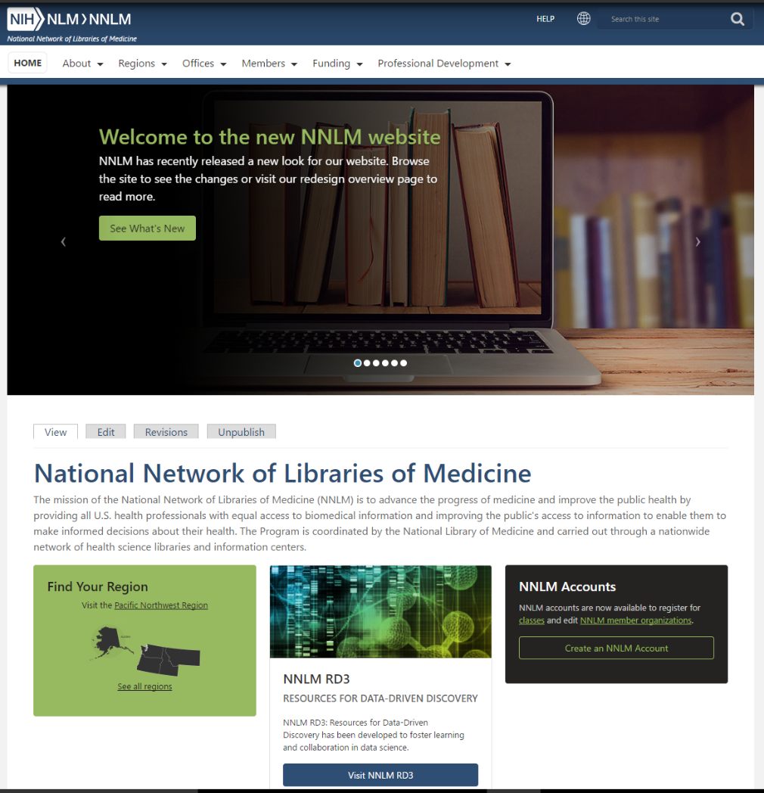
NNLM Accomplishments, Year 1 (May 2016—April 2017)
Notes:
We’re a grant!
New look to nnlm.gov!
Focus on data!

Slide 12
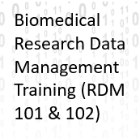
NNLM Accomplishments, Year 2 (May 2017—April 2018)
Notes:
RDM101 & 102
First for NNLM -- All of Us partnership, approximately $21.7M additional dollars added to NNLM program over 4 years. This partnership was possible through the efforts to restart a partnership with the Public Library Association by one of our regions, which, in turn, became a national initiative. For the 2021-26 cycle, we hope to replicate the funded partnership with All of Us to other areas of NIH.
In the past 4 years the NNLM has partnered with the All of Us Research Program in their community engagement, education, and training efforts. This partnership has resulted in considerable benefits to both partners. For the All of Us Research program the NNLM provides a national coordinating Center for Community Engagement and a national Training and Education Center for developing culturally and linguistically appropriate health information materials and training for the public and researchers. Training materials and approaches focus primarily on engaging digital strategies and have ranged from programs for citizen science to ethical and cultural practices for researchers.

Slide 13
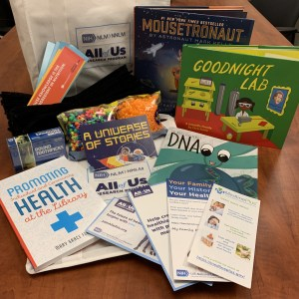
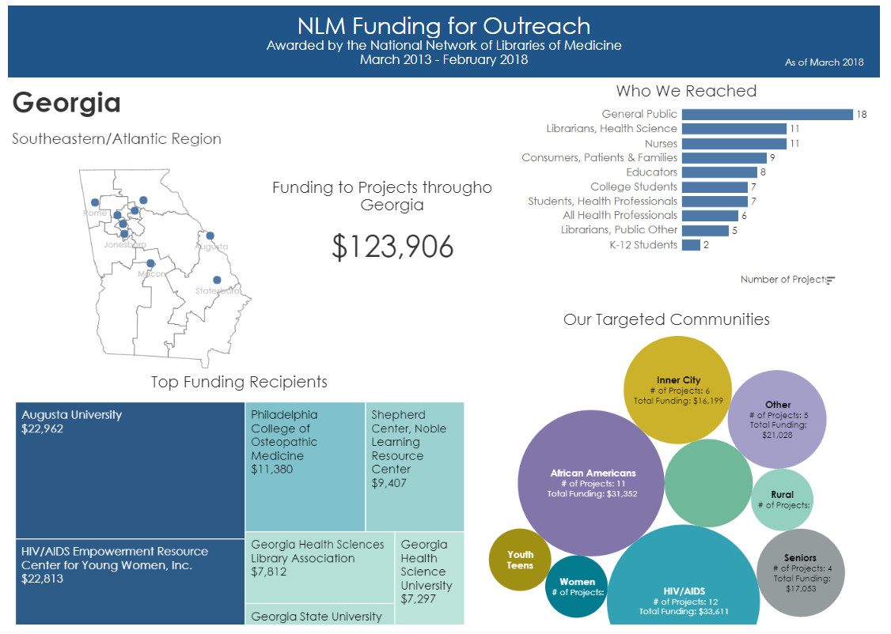
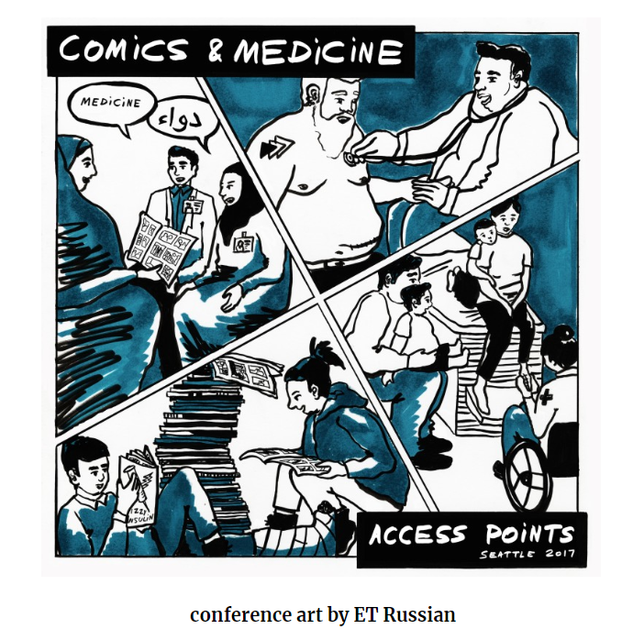
NNLM Accomplishments, Year 3 (May 2018—April 2019)
Notes:
In year 3 of the current cycle the accomplishments continued, ranging from
NNLM Pacific Northwest Region and New England Region co-sponsor and support the 2017 Comics and Medicine conference: https://www.graphicmedicine.org/2017-seattle-conference/
NNLM South Central Region providing Hurricane Relief Support; NNLM SEA also contributed to ALA’s Disaster Relief Fund to support Libraries in PR and USVI
More visual NNLM data: https://nnlm.gov/about and https://public.tableau.com/profile/national.network.of.libraries.of.medicine#!/
#CiteNLM2018 Wikipedia Edit-a-thon: https://nnlm.gov/wiki and https://infocus.nlm.nih.gov/2018/04/10/getting-it-right-on-rare-diseases-the-national-network-of-libraries-of-medicines-first-citenlm2018-edit-a-thon-on-april-17/
Training stats:
Past Year:
20167 registrants for 261 class instances
Top 5 classes offered (by registration)
7/25/2018 DOCLINE Talkline: Introducing DOCLINE 6.0 630 NDCO
2/28/2019 Health Statistics on the Web 468 MAR 4/10/2019 DOCLINE Talkline: What's New? 412 NDCO
1/11/2019 MeSH Changes and PubMed Searching 389 National
1/4/2019 2019 MeSH Highlights 337 National
1/23/2019 From Problem to Prevention: Evidence-Based Public Health 306 MAR
April 2019 NNLM Training Stats:
27 classes offered
2860 registrants
824 training evaluations completed
85% learned a new skill

Slide 14
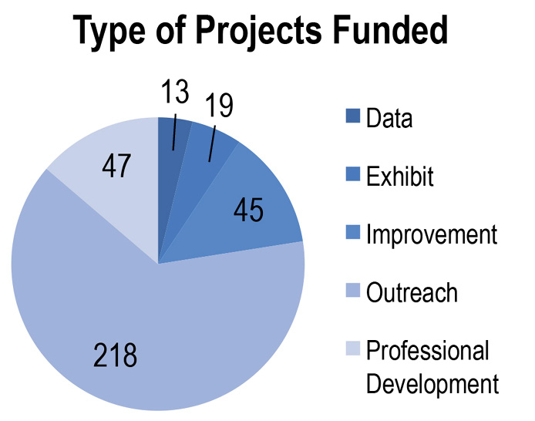
NNLM Accomplishments, Year 4 (May 2019—April 2020)
Year by the Numbers
8,261 member organizations
4,061 activities reaching 1,535,685 participants
583 projects conducted by 398 lead organizations
342 projects and 1,513 activities funded
Notes:
In the most recent concluded budget year, successes continued. As mentioned earlier, NNLM funded 342 projects. Over $5.1M in funding was dispersed to members and partners to develop and implement health information outreach and engagement projects.
This past year also saw us adapt to the COVID-19 response. This resulted in a 41% increase in pageviews and user sessions from the previous year. And our class with the highest registration for the year: Putting the Self back in Self-Care: Wellness in the time of COVID-19 and most watched video Providing Virtual Programming in a Health Crisis (which had over 3,000 views in a 6-week period).
***
NNLM Funding and Activities Supported
342 projects funded*
1,513 subaward activities funded
560 cities or towns reached by funded activities**
$5,107,369 in funding awarded to projects.
*projects that were awarded, completed, or in progress at any point during Year 4. Projects and activities are included regardless of whether they were impacted by COVID-19.
**defined by zip code
***
Class with highest registration: Putting the Self back in Self-Care: Wellness in the time of COVID-19.
***
NNLM.gov Website Data
(1 May 2019 - 30 April 2020 compared to 1 May 2018 - 30 April 2019)
A 41% increase in pageviews and user sessions from the previous year (1.5 million pageviews and 658,000 sessions during reporting period)
Total users increased 67% (499,872 vs. 299,416 users)
New users increased 68% (495,365 vs. 295,571 users
Numbers of sessions increased 54% (658,262 vs. 427,465 sessions)
Among 10 most viewed pages:
Health Literacy
Discover NNLM Training Opportunities
Free Materials
Class Catalogue
Evaluating Health Websites
Most watched video: Providing Virtual Programming in a Health Crisis (over 3,000 views in a 6-week period).

Slide 15
How to Get More Information on the NNLM Program
nnlm.gov
nnlm.gov/workbook
Notes:
Web image: This Photo by Unknown Author is licensed under CC BY-SA
Email image: This Photo by Unknown Author is licensed under CC BY-SA
I hope this information has provided you with a sense of the NNLM program and our successes providing training, funding, and engagement opportunities over the past 5 years.
As I stated at the outset, this information and more is available on the NNLM organizational handbook and the nnlm.gov website. Please start there for information about the NNLM’s programs. If you have any further questions, there are emails on the NNLM organizational handbook and in the last slide of this presentation to which you can direct any information.
After a pause for any questions, I will hand it off to Dr. Alan VanBiervliet to talk about our goals for the next 5 years of the NNLM program, as outlined in the FOA.

Slide 16
Pause for Questions

Slide 17
UG4 2021-2026 Application Processes and Strategies
Alan VanBiervliet, MA PHD - UG4 Program Official
Topics
Cooperative Agreement Grant
Milestones
Initial Planning
RMLs and Offices
Staffing, ERA Commons
Budget, Indirect Costs/F&A
Letters of Support, Appendix
Subawards/Consortia
Human Subjects
NNLM Evaluation Center FOA
ASSIST and General Tips

Slide 18
NIH Funding Mechanisms
Grants - Designed to meet specific aims created by the applicant. Flexible approach based on data collected and changes in science and technology. Flexible budget modifications and carry over of funds between budget years. Little involvement by NIH staff in grant operation. Typically used for research projects. Majority of NIH funding.
Contracts - Outcomes of the project based on NIH written criteria. Project activities limited to specifications in the contract. Typically specific timelines with objective milestones. Budget modification is limited.

Slide 19
Cooperative Agreement Grant
Partnership between NIH and Awardee. Flexible approach to achieving aims based on data collected and changes in science and technology. Flexibility in budget modifications. No automatic carry over of funds between budget years. Commonly used for resource development, research networks, and programs in support of NIH mission.
Notes:
Grants are not contracts and it is common that tasks are not performed exactly as written in the application. The aims however, typically remain consistent. Grant Applications are written and submitted over 9 months or longer before funding begins and needs and technology often change during this time period. .So there are often changes in the methodology used to achieve the aims when the project begins. Also reviewers as well as NLM staff can recommend changes before awards. With the NNLM there is also the issue of coordinating your plans with the other awardees to create an effective national program. So be prepared for changes to occur.

Slide 20
Cooperative Agreement Grant
Significant involvement by NIH staff as:
Project Scientists (programmatic partners and advisors)(OET staff)
Project Coordinator (NLM and NIH liaison, facilitates national coordination) (OET staff)
Project Official (standard grant stewardship)

Slide 21
Milestones
Significant involvement by NIH staff as:
UG4 FOA Published June 17, 2020
Receipt Deadline September 11. 2020
Review December 2020
NLM Board Review January 2021
Final Funding Decision February 2021
Award negotiation Notice of Award March/April 2021
Start date May 1, 2021

Slide 22
Milestones
Review Process
Special Emphasis Panel – external experts following standards NIH review quality assurance procedures
Meeting December 2020
Separate scores for the RML and the Optional Network Offices
It is very important to write the application with the review criteria in mind.
Notes:
Best laid plans can be disrupted by events out of our control The impacts of the COVID-19 Pandemic are somewhat predictable by following the data, but the 2021 budget which is less predictable.. Currently we have no 2021 budget, this is an election year, and the budget has been late for many years.

Slide 23
Initial Planning
Carefully study the funding opportunity announcement https://grants.nih.gov/grants/guide/rfa-files/RFA-LM-20-001.html (there are many links to important information)
Work closely (make friends) with your Grants Office.
Work with a university colleague who has experience with complex NIH applications.
Notes:
Many faculty have the mistaken idea that NIH grants are theirs, however, NIH grants are only awarded to registered organizations like universities, hospitals and private companies, not individuals.

Slide 24
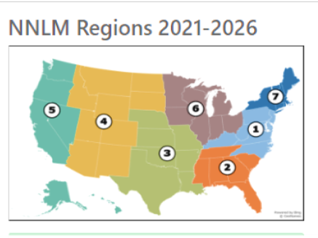
Regional Libraries of Medicine and National Offices
8 Regional Libraries of Medicine
3 Optional National Offices designed to serve the entire Network of the National Library of Medicine – housed within an RML with an autonomous head and separate budget. Could be a subaward.
Notes:
With the reorganization this cycle there will be some transition in every region. Thus it is important to plan for the transition during the first year of the 5 year cycle.

Slide 25
Regional Libraries of Medicine and National Offices
Component Types Available in ASSIST | Page Limits
Overall | 6
Administration Core | 6
Regional Medical Library | 12
Optional NNLM Offices
NNLM Web Services Office | 6
NNLM Training Office | 6
NNLM Public Health Coordination Office | 6

Slide 26
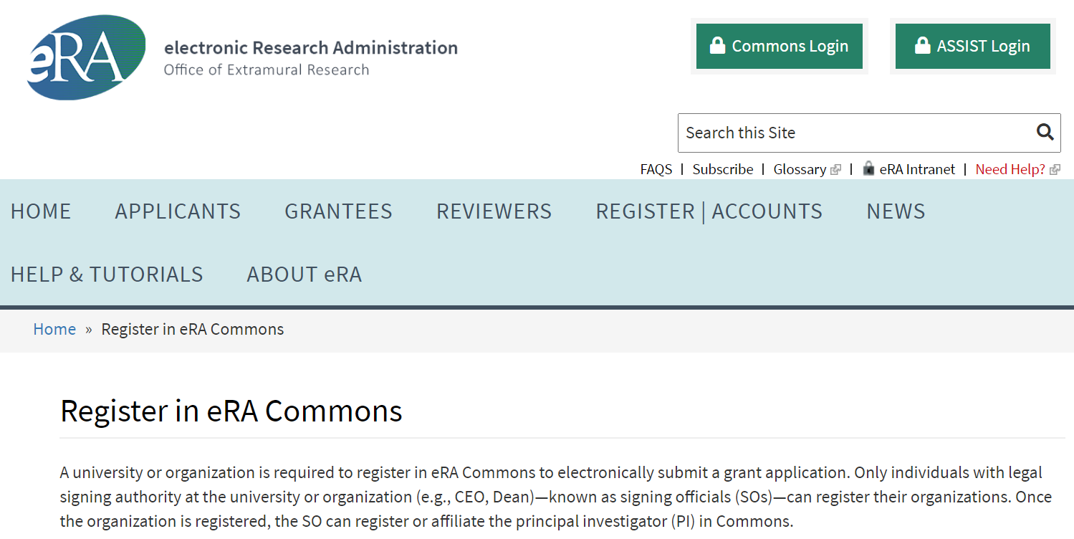
eRA Commons
NIH communication system with PIs and University Officials
PI needs to have active eRA Account, check this immediately
Assistant to PI can also be assigned access to PI eRA account
Notes:
Get help with your budget. The UG4 is a complex application and a complex budget. Experience with NIH budgets is a valuable asset in developing the UG4 budget.

Slide 27
Budget
Regional Medical Libraries - Applicants may request up to $975,000 in direct costs per year for each of the seven.
NNLM Web Service Office - Applicants may request up to $398,000 in direct costs per year.
NNLM Training Office - Applicants may request up to $531,000 in direct costs per year.
NNLM Public Health Coordination Office - Applicants may request up to $341,000 in direct costs per year.
UG4 applications are eligible to request Facilities & Administration (Indirect) Costs at the organizations federally approved Other Support Rate, typically at 30-36%. Subawards can also claim F&A costs .
Notes:
Get help with your budget. The UG4 is a complex application and a complex budget. Experience with NIH budgets is a valuable asset in developing the UG4 budget. A major part of the budget for all RMLs, and somewhat less so for the offices, is support for the projects with community and Network partners. For example, last year the NNLM supported 342 funded projects for over $5,100,000. This represents a significant commitment from the budget. Based upon what we have learned the about the success of online learning and communication, we expect to see less expenditure in the future on travel, we expect to see the use of more efficient and perhaps more effective strategies for participating in meetings and training in the future.

Slide 28
Staffing
Include biosketches for critical program staff, including PI/PD, Executive/Associate Director, Office Head and all staff who have a significant role in the planning and implementation of the program. In ASSIST these are all listed as Senior/Ker Personnel.
You can also list and include biosketches for Administrative leadership staff as well.
Amount of effort/time expressed as Person Months. https://nexus.od.nih.gov/all/2017/03/31/what-is-a-person-month-how-do-i-calculate-it/
Consider project management.
Describe staff roles in Budget Justification section.
Notes:
The largest budget category for the NNLM is staff. An important lesson we have learned as we have moved to a stronger national approach is the ability to partner and share responsibilities with both NNLM RML and Office partners and with Network partners. Like Tom Saywer we can get the job done more efficiently and often better by partnering with others.
Last year the NNLM supported 342 projects primarily through subwards and contracts. The RMLs and Offices have a responsibility to make awards in a fair and transparent manner as well as to monitor both subawards to ensure progress is being made and that federal expenditure guidelines are being followed. As you can image doing this monitoring for 40 or more awards in a year is complex and time consuming. Although the NNLM as a whole is developing more effective project solicitation, review, award, and reporting procedures (see the NNLM Workbook) each RML and Office has substantial project responsibilities as well. Effective project management should be one of the considerations when staffing and planning your program.

Slide 29
Letters of Support and Appendix
These should be letters of commitment from individuals/organizations stating the willingness to commit staff time or other resources to achieve project aims.
Letters that apply to the entire application (or to multiple components) should be combined into a PDF file and attached to the Letters of Support section in the Overall Component.
Letters that apply to only one core/component should be combined in a PDF and attached to the Letters of Support for that core/componet.
Basically an Appendix is not allowed in the UG4 application

Slide 30
Subawards/Consortium
Subawards/consortium can be included in the UG4 application.
Work with your grants office on what procedures you must follow at your university.
If you include a subaward it must include a standard NIH budget form, personnel time costs in calendar months, budget justification, and description of project.
Subawardees are entitled to claim indirect costs.
You can also propose a community engagement type subaward program.
The Awardee is responsible in ensuring subaward funds are spent appropriately and subawards are properly managed.

Slide 31
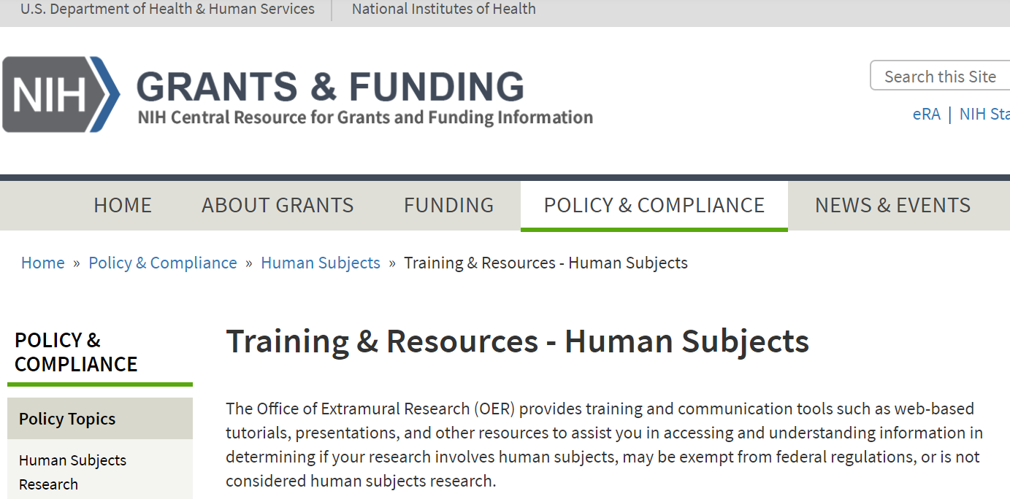
Human Subjects Protection
Limited human subject research is allowed with UG4 funding.
Staff must complete human subject protection training according to their university guidelines. https://grants.nih.gov/policy/humansubjects/training-and-resources.htm
UG4 human subject research policies are under development
Prior to including a human subject research proposal in your application contact Dr. Alan VanBiervliet at alan.Vanbiervliet@nih.gov
Notes:
We have seen only a few projects in the last few years that involved human subject research. It is the responsibility of the RMLs and Offices to carefully examine every project that plan to fund, both internally and as subawards, to determine whether it involves human subject research and follow the appropriate procedures for their University.

Slide 32
NNLM Evaluatiion Center FOA https://grants.nih.gov/grants/guide/rfa-files/RFA-LM-20-002.html
The NNLM Evaluation Center (NEC) will coordinate the assessment of the impact, efficacy and value of NNLM activities, services, and resources. A special focus will be placed on assessing community engagement and measuring its impact on persons who experience health disparities, and populations underrepresented in biomedical research. The NEC’s activities will include, among others, developing evaluation tools, planning studies, providing evaluation training to the RMLs, Offices, Centers, and sub-awardees of the NNLM, and assessing the effectiveness of national initiatives and selected programs.
Notes:
Evaluation is an important part of your planning for the RML and optional Offices. Carefully reviewing the previous work of the National Evaluation Office via the Workbook and the links to NEO and reviewing the funding opportunity announcement for the NEC will provide useful guidance.

Slide 33
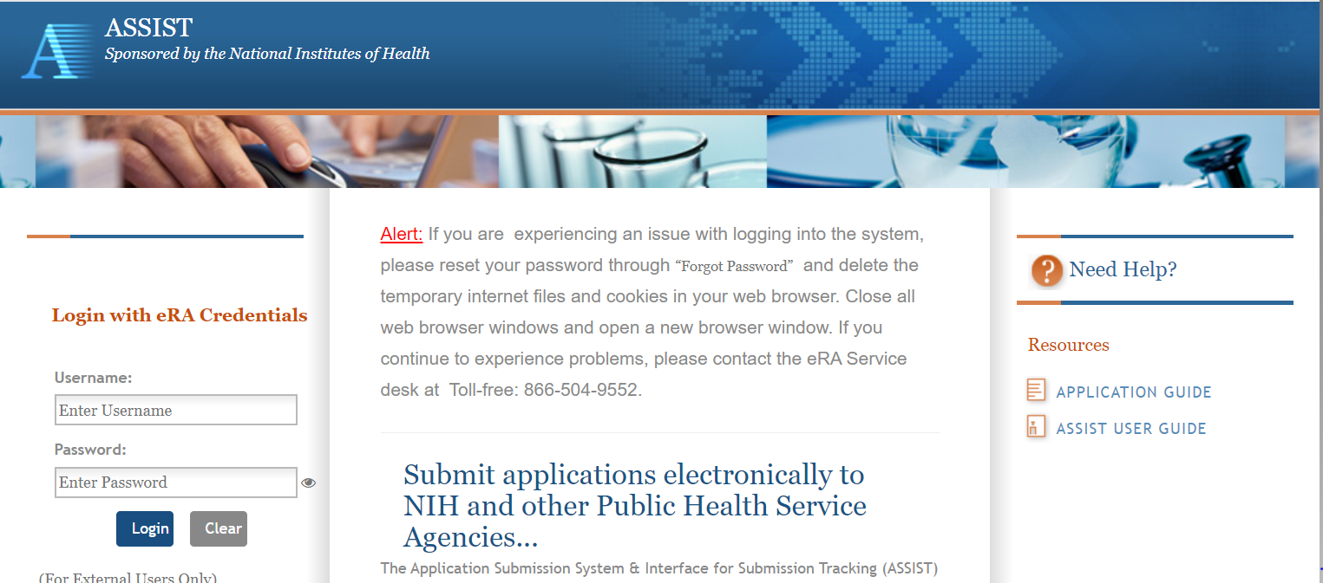
ASSIST and the Application Process https://public.era.nih.gov/assist/
ASSIST is an online system that NIH applicants use to prepare and submit complex applications such as the UG4.
Notes:
NIH provides the Application Submission System & Interface for Submission Tracking (ASSIST) system is used to prepare and submit applications electronically. The application process is complex, time consuming, and must be completed in in a relatively short time. It typically takes a village to successfully complete. Even the Lone Ranger needed assistance. Start early and obtain help from others who have successfully used ASSIST. There is online , email, and phone assistance for ASSIST.

Slide 34
Contacts
Programm Questions
Alan VanBiervliet, MA PhD National Library of Medicine (NLM) Telephone: 301- 594-4882 Email: alan.vanbiervliet@mail.nih.gov
Peer Review
Zoe Huang, MD National Library of Medicine (NLM) Telephone: 301-594-4937 Email: huangz@mail.nih.gov
Financial/Grants Management Contact(s)
Samantha Tempchin National Library of Medicine (NLM) Telephone: 301-496-4221 Email: tempchins@mail.nih.gov

Slide 36
Contacts
Programm Questions
Alan VanBiervliet, MA PhD National Library of Medicine (NLM) Telephone: 301- 594-4882 Email: alan.vanbiervliet@mail.nih.gov
Peer Review
Zoe Huang, MD National Library of Medicine (NLM) Telephone: 301-594-4937 Email: huangz@mail.nih.gov
Financial/Grants Management Contact(s)
Samantha Tempchin National Library of Medicine (NLM) Telephone: 301-496-4221 Email: tempchins@mail.nih.gov

